Slide 1
第一次组会
汇报人：耿兆楣

Slide 2
Multimodality neuroimaging brain-age in UK biobank: relationship to biomedical, lifestyle, and cognitive factors
UKB的多模态神经成像脑年龄：与生物医学、生活方式和认知因素的关系
使用健康人的神经影像建立大脑年龄模型
->
使用神经成像数据预测实际年龄与健康、生活方式和认知功能相关因素之间的关系
->
评估来自新个体的神经成像数据

Slide 3
Participants
n = 22,392 participants from UK Biobank
n = 17,461 participants (aged 45–80 years, n = 9274 females, n = 8187 males) with complete neuroimaging data
training set：only people who met criteria for being healthy at the time of scanning
n = 2725 (mean age = 61.47 ± 7.2 years, 1343 females and 1382 males)
Exclusion criteria：ICD-10 diagnosis, a self-reported long-standing illness disability or infirmity (UK Biobank data field #2188), self-reported diabetes (field #2443), stroke history (field #4056), not having good or excellent self-reported health (field #2178)
test set：the remaining n = 14,701 participants (mean age = 62.64 ± 7.5, 7914 females, 6787 males)

Slide 4
Data processing
Data from resting state fMRI were so-called bulk data, in this case the 25-dimension partial correlation matrices (data field #25752). These matrices had been converted into vectors of length 210, representing the pairwise correlations between the BOLD timeseries from 21 separate resting state networks
The figure of 210 values is arrived at by 21 networks multiplied by 20 (i.e., excluding the identity correlation), then divided by 2 (i.e., as the matrix is diagonally symmetrical).

Slide 5
Statistical analysis
define a multimodality healthy aging model ：
training data were randomly split into separate training (80%, n = 2205) and validation sets (20%, n = 520)；All neuroimaging phenotypes were normalized
predict age from neuroimaging data：LASSO regression
age ：outcome variable
neuroimaging phenotypes（神经影像学表型）：predictors
an L1-norm penalty；
Coefficients that shrink below a threshold (lambda) are automatically set to zero；
To derive the optimal value lambda, 10-fold cross-validation was first run using a range of lambdas, and the highest value within one standard error of the minimum was used in subsequent analysis；
bootstrapping was used to generate a distribution of coefficients for each predictor variable；

Slide 6
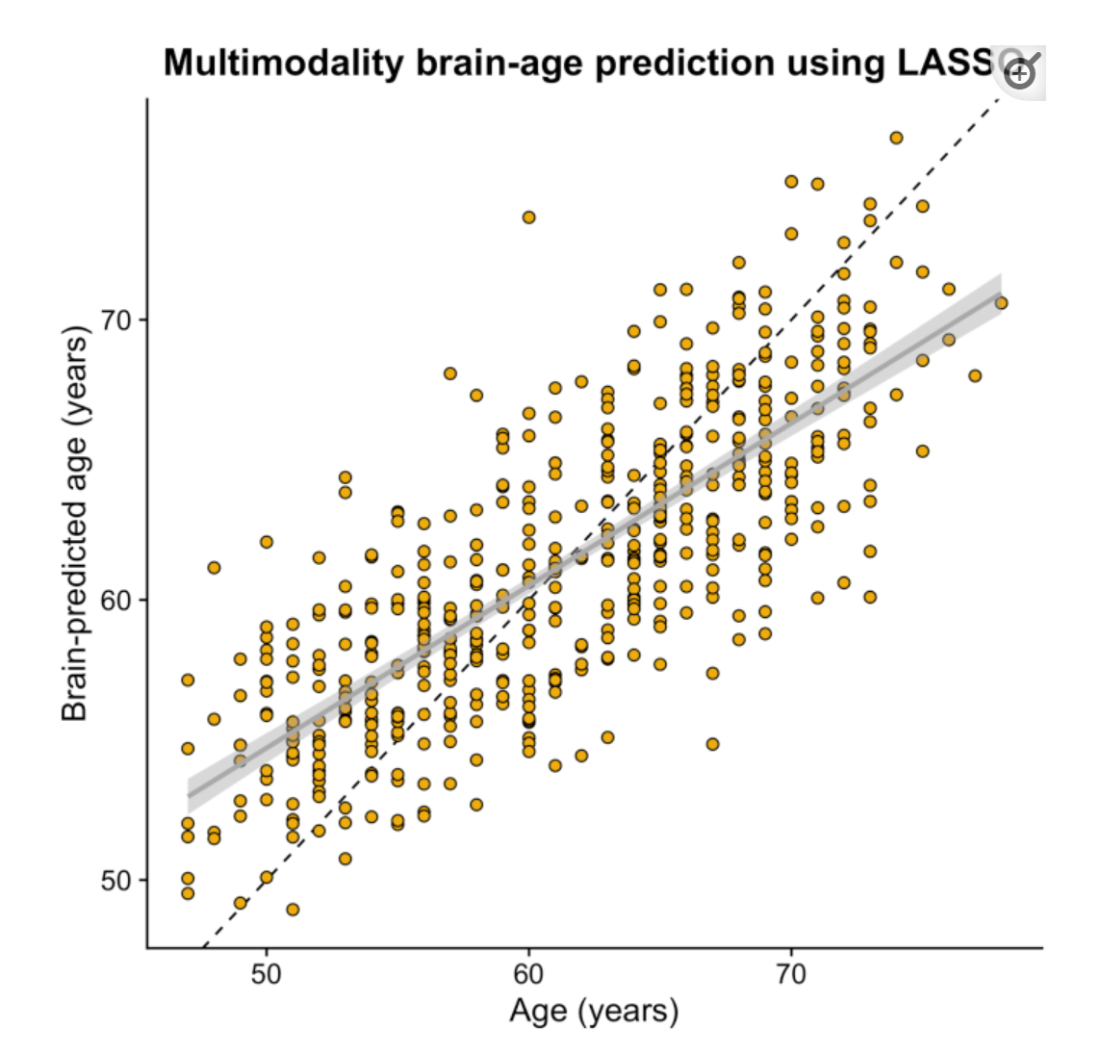
Brain-predicted age from multimodality LASSO regression model. Scatterplot depicting chronological age (x-axis) by brain-predicted age (y-axis) in UK Biobank validation set (n = 520). Black line is the line of identity. Gray line is the regression line of age on brain-predicted age with shaded errors representing the 95% confidence intervals. No age-bias correction had been applied at this stage.

Slide 7
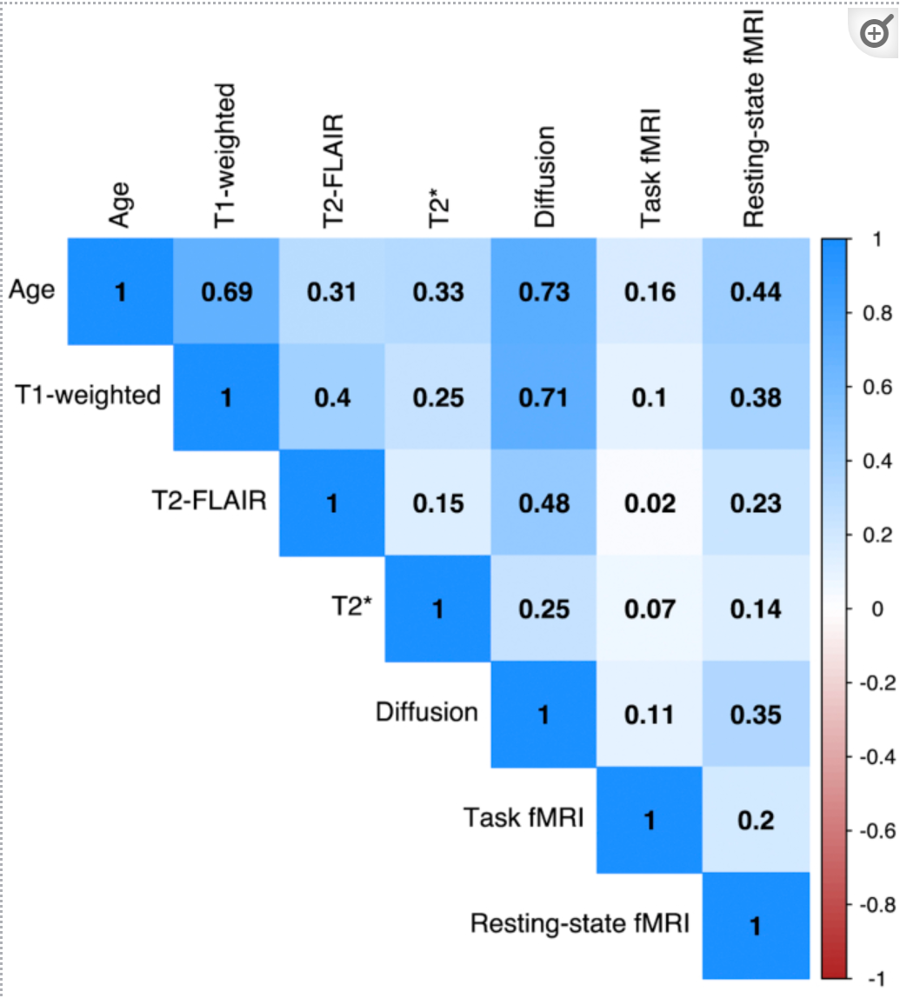
Correlation matrix of age and brain-age predicted by 6 different modalities. Bivariate correlations between chronological age and brain-age values derived from each of the 6 neuroimaging modalities, in the validation set (n = 520).
The LASSO regression procedure was then run per modality (T1-weighted, T2-FLAIR, diffusion-MRI, SWI, task fMRI, resting-state fMRI)；the LASSO was repeated using a leave-one-modality-out approach, the inverse of the single modality analysis, to test whether including some modalities decreased model performance

Slide 8
To test for associations between brain-age and health-related variables in UK Biobank, the LASSO model was applied to predict age in people from the testing set: calculating the regression line between age (predictor) and brain-predicted age (outcome) in the training set, applying the age-bias correction
-> brain-predicted age difference (brain-PAD)
positive values: an older-appearing brain
negative values: a younger-appearing brain

Slide 9
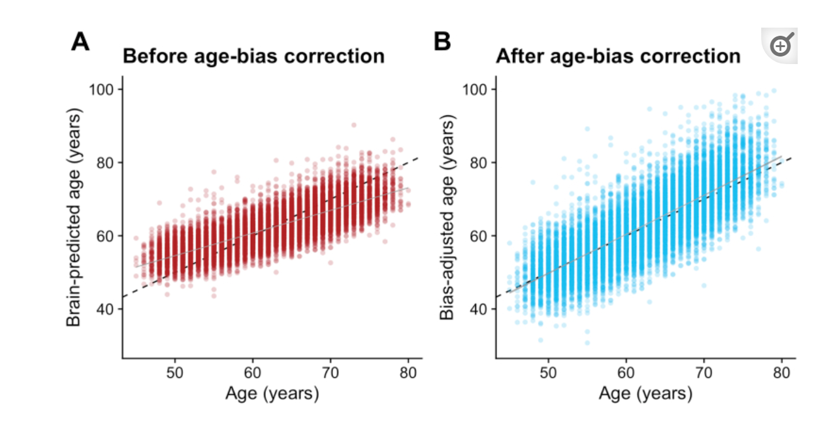
Scatterplots depicting chronological age (x-axis) by brain-predicted age (y-axis) in UK Biobank test set (n = 14,701). Black line is the line of identity. Gray line is the regression line of age on brain-predicted age with shaded areas representing the 95% confidence intervals.

Slide 10
Associations between brain-PAD values and demographic, biomedical, cognitive, and lifestyle measures were then tested, using linear regression models.
brain-PAD: outcome measure
the variable of interest: predictor
age, age², sex, height, volumetric scaling from T1-weighted MRI to standard (data field #25000), and mean task fMRI head motion (averaged across space and time points; data field #25742): covariates.

Slide 11
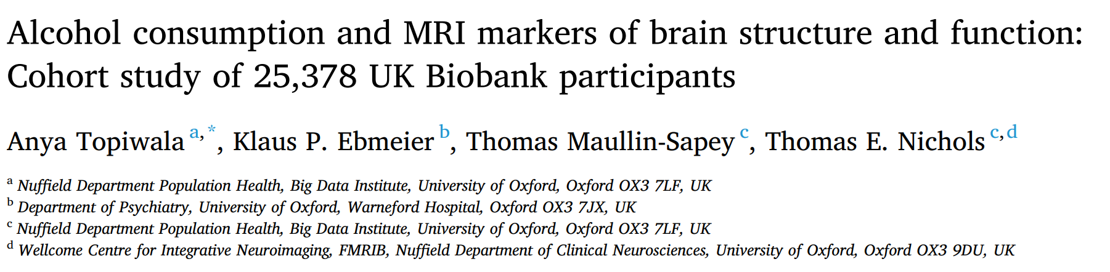
饮酒和大脑结构和功能的MRI标记：25378名UK Biobank参与者的队列研究

Slide 12
Variables of interest were included as potential confounders because of associations with neuroimaging measures:
age at scanning and sex
smoking status (reported in categories:never/previous/current)
educational qualifications
systolic (SBP) 收缩压and diastolic (DBP) 舒张压blood pressure
Body mass index (BMI)
Townsend Deprivation Index汤森剥夺指数
weekly exercise expenditure
diabetes mellitus diagnoses
depression cases

Slide 13

炎症与抑郁和焦虑的关系：症状特异性和潜在因果关系的来自UK Biobank和NESDA cohorts的证据

Slide 14
Covariates
age
sex
socioeconomic status (SES)（measured via the Townsend Deprivation Index ）
smoking (current/former/never)
quantity of alcohol consumption
type and time spent in physical activity
lifetime history of type two diabetes (T2D)
cardiovascular diseases(CVD)
body mass index (BMI)

Slide 15

流行前精神障碍与新冠肺炎风险： UK Biobank队列分析

Slide 16
Covariates
sociodemographic characteristics (birth year, sex, and race or ethnicity)
socioeconomic factors (Townsend deprivation index, educational attainment, and annual household income)
lifestyle factors (smoking status)
Bodymass index (BMI)
Townsend deprivation index
history of somatic diseases that could affect COVID-19 susceptibility or course

Slide 17
UK Biobank : Data Dictionary for Application 68640
UK Biobank : Data Dictionary for Application 68640
UDI - the Unique Data Identifier for an item of data within the UK Biobank repository.
Count - the number of non-empty rows present in this dataset.

Slide 18
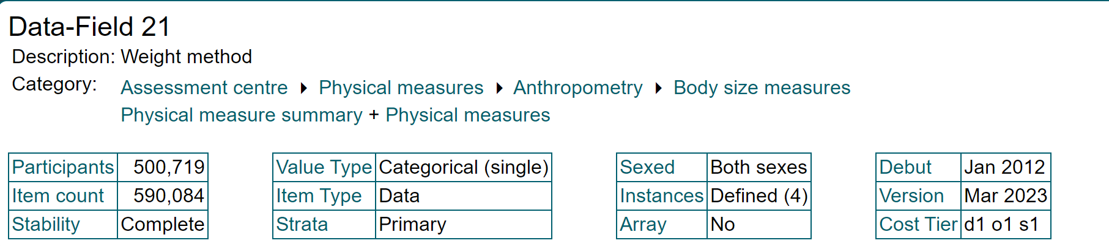
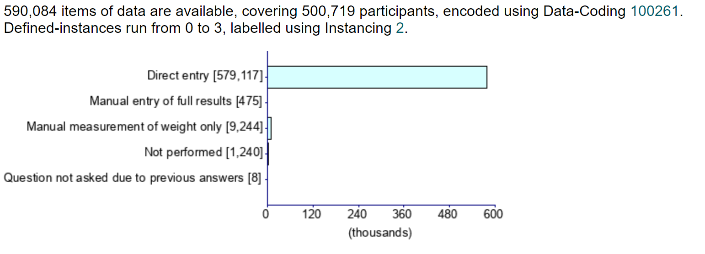
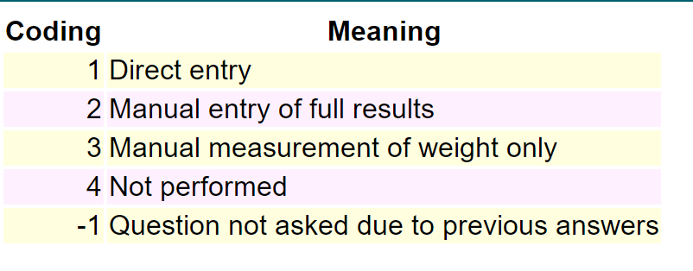
Weight method
Indicates whether weight was entered into the machine directly or manually, whether weight was only measured manually or not performed

Slide 19
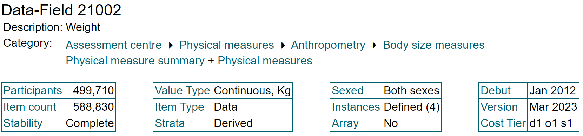
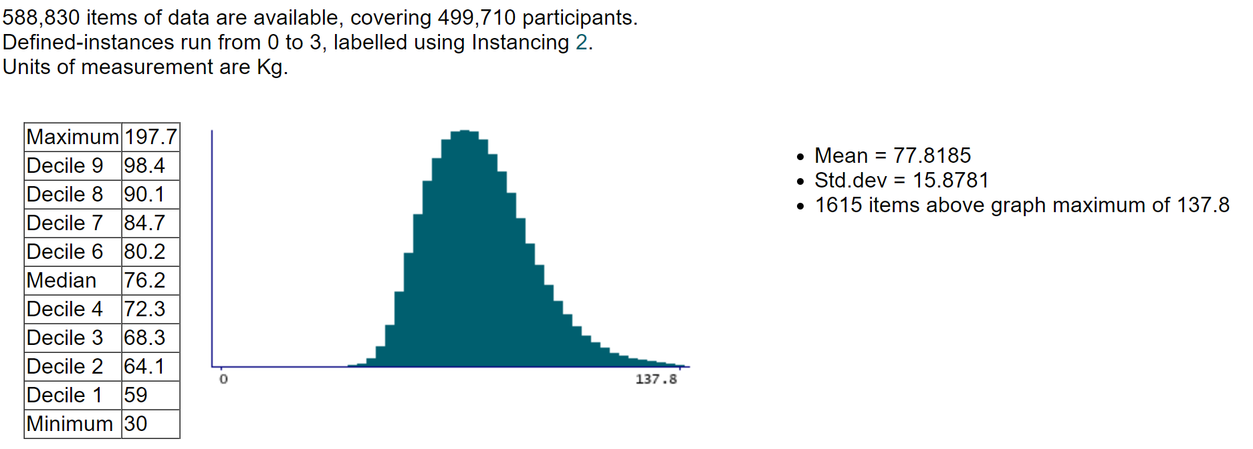
Weight

Slide 20
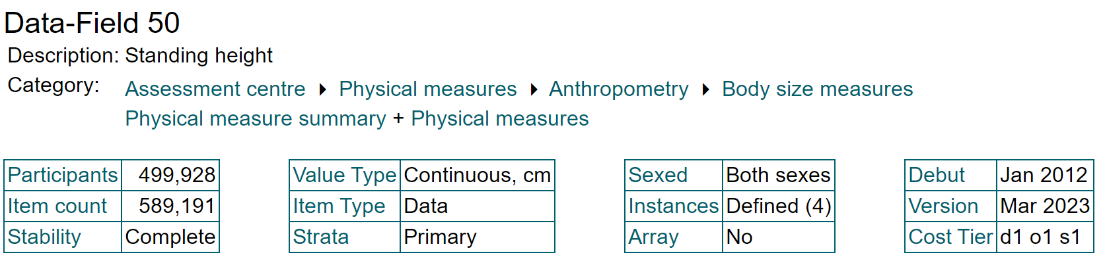
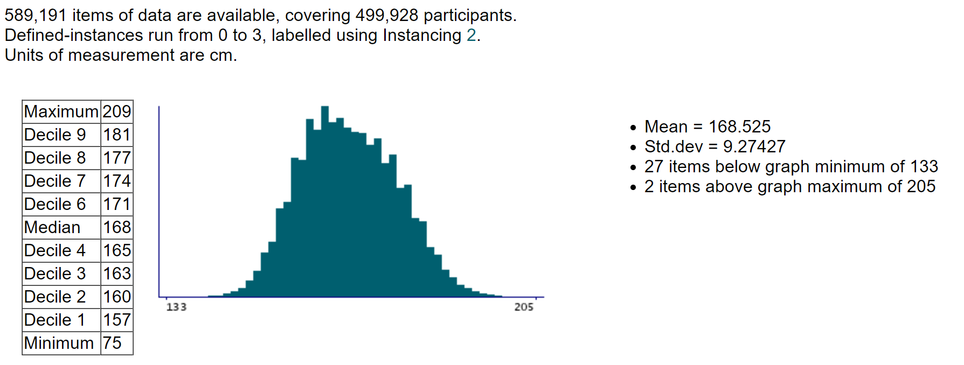
Standing height
Standing height was measured using a Seca 202 device

Slide 21
Standing height
Resource 100141
Resource 100142
Name: Height measurement
Size: 1,226,740
MD5: 16b3bac05a9d4d0f4bf450099ee2b029
Participant having standing height measured
Name: Height positioning
Size: 1,540,449
MD5: 508f13c90736694192f202d1324ee58d
Participant being put into correct position for height measurement

Slide 22
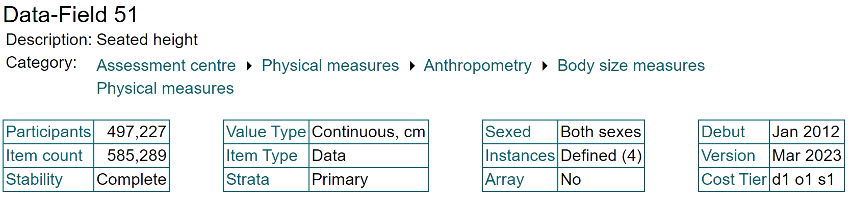
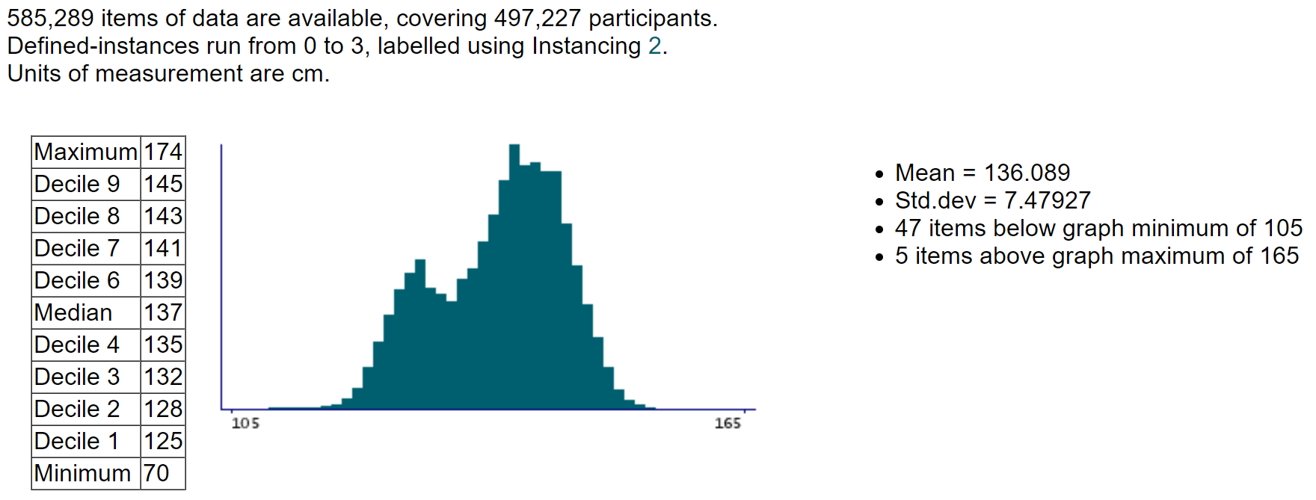
Seated height

Slide 23
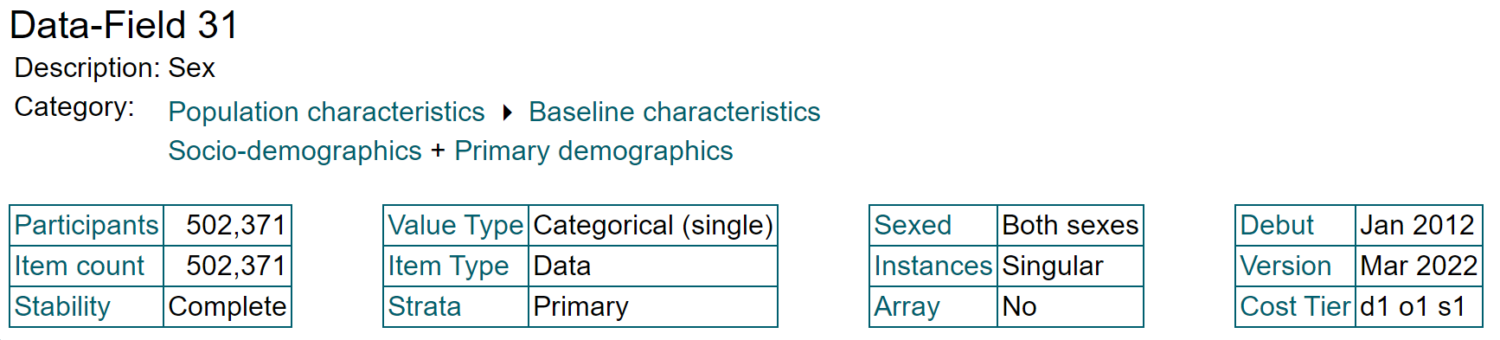
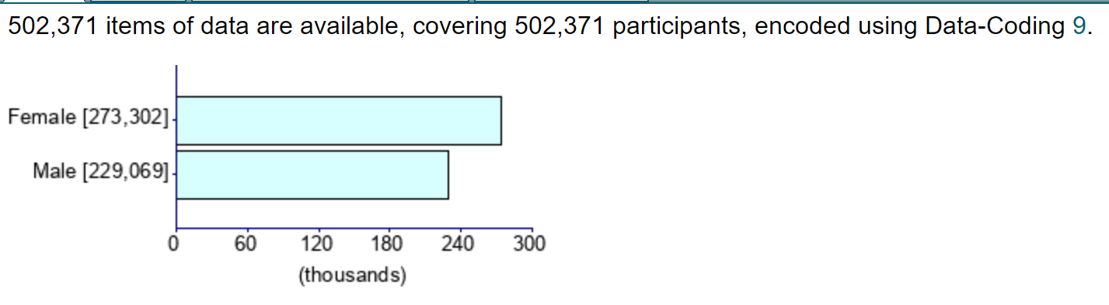
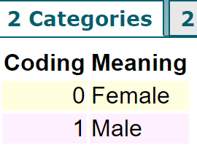
Sex

Slide 24
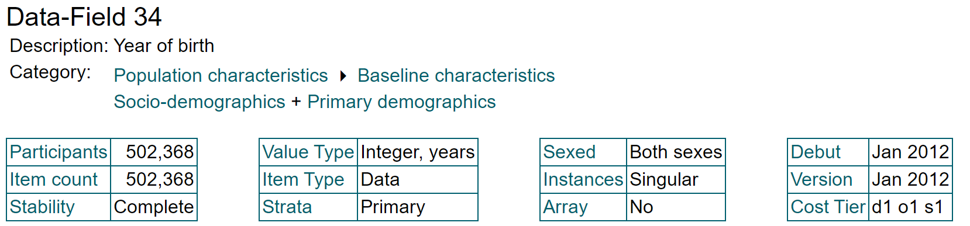
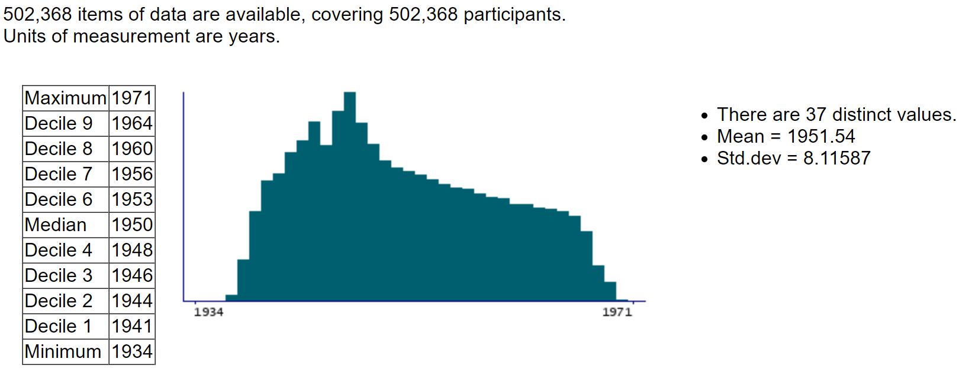
Year of birth

Slide 25
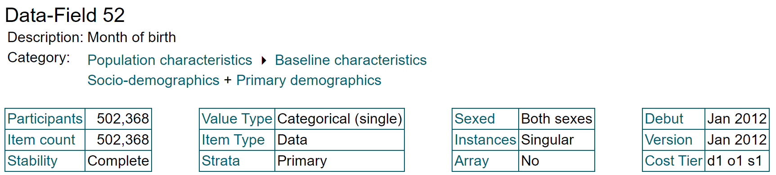
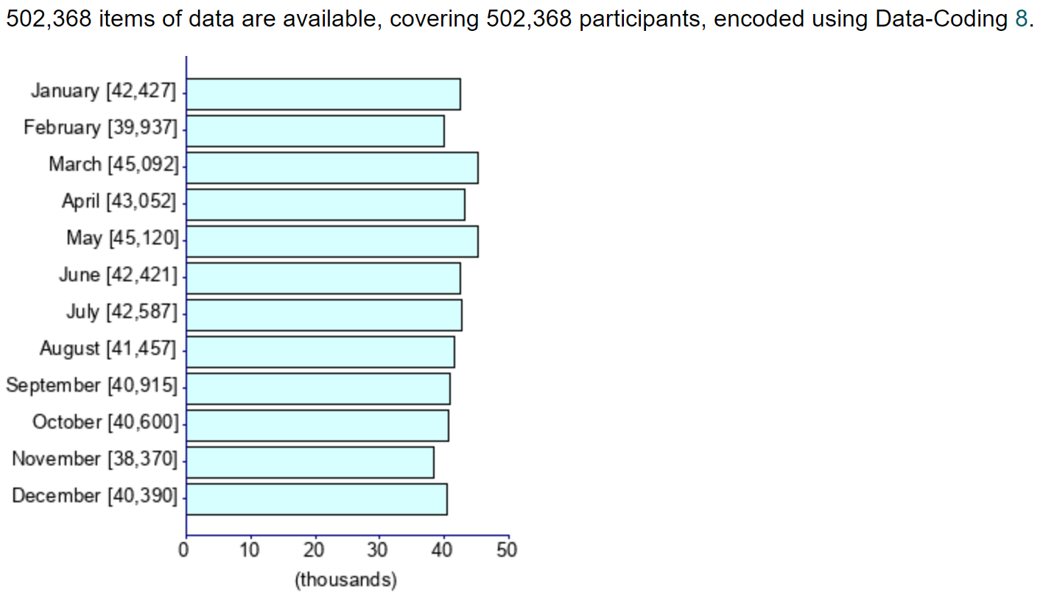
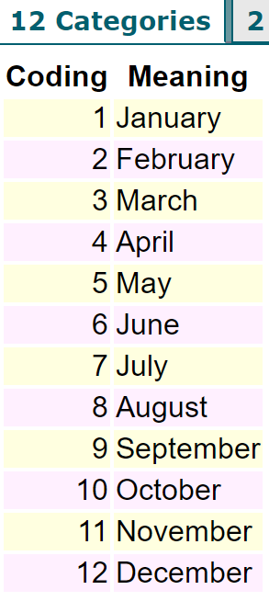
Month of birth

Slide 26
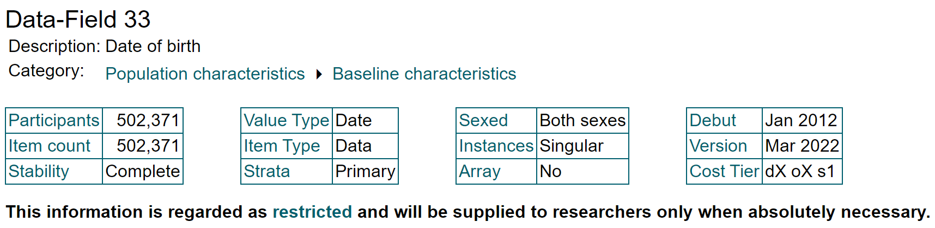
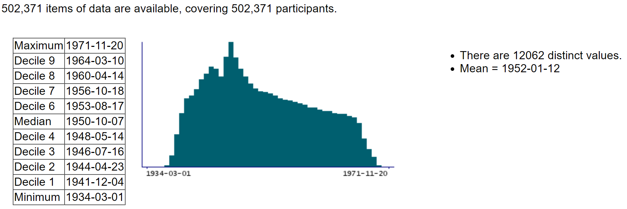
Date of birth

Slide 27
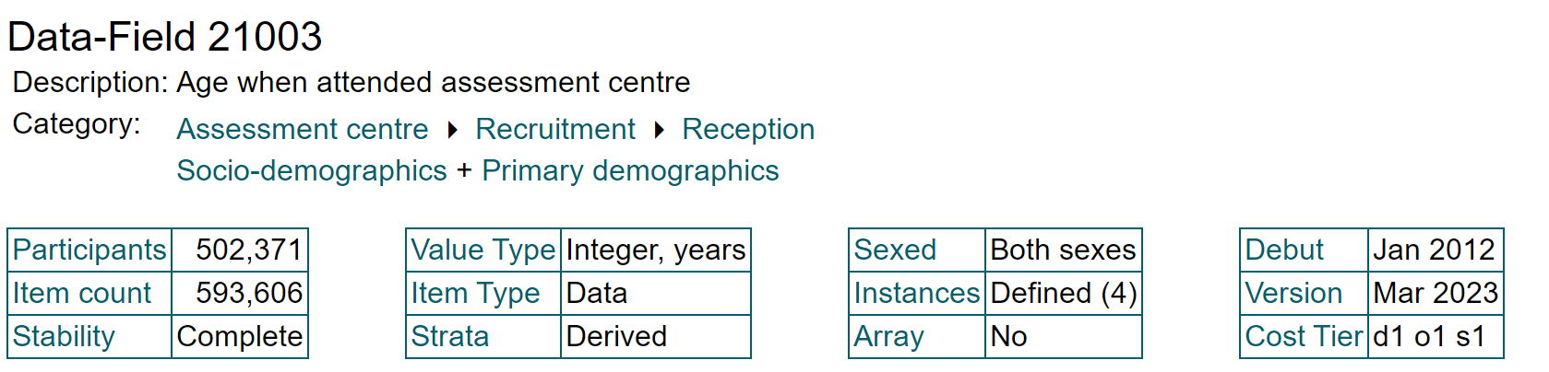
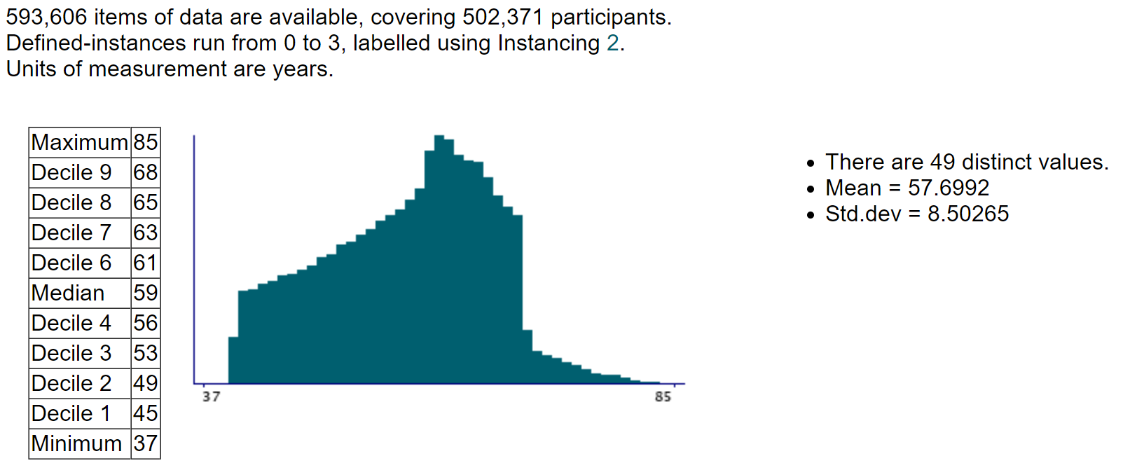
Age when attended assessment centre

Slide 28
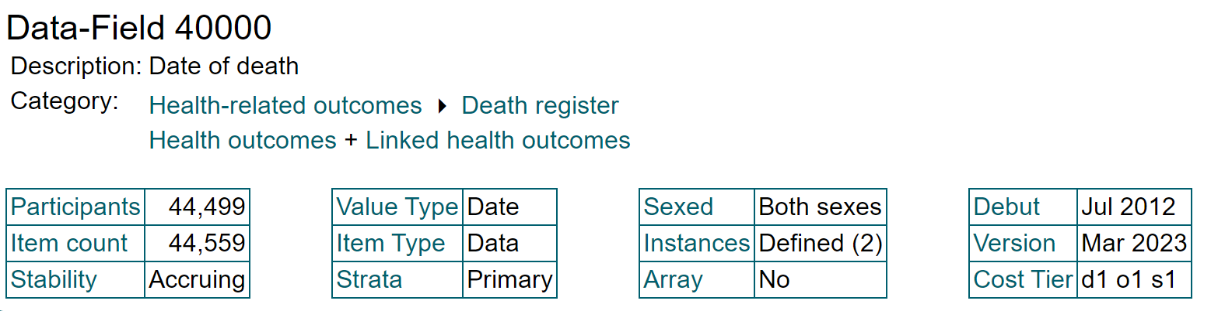
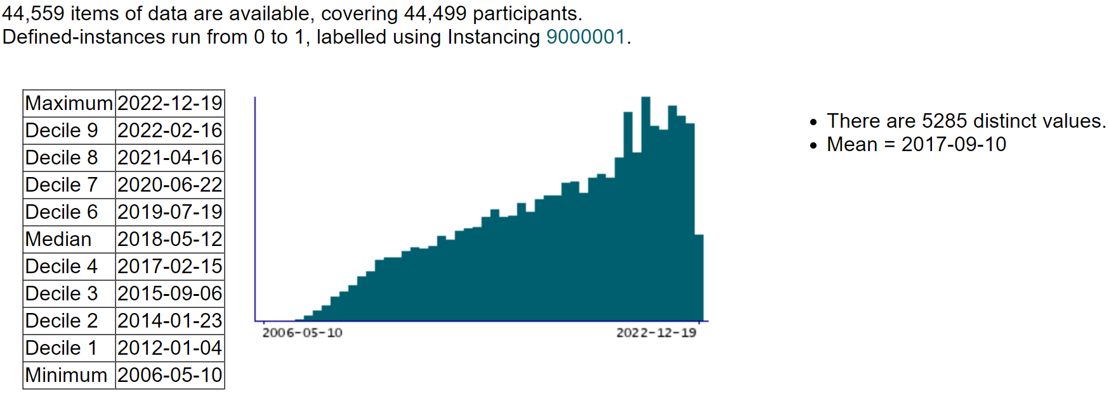
Date of death

Slide 29
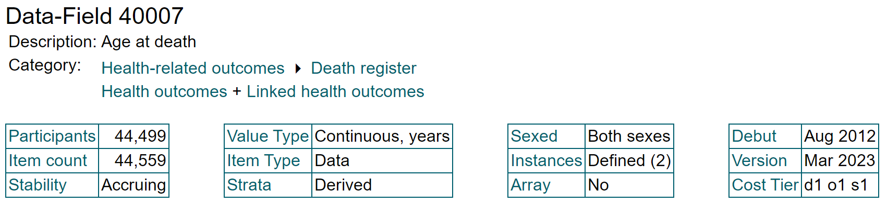
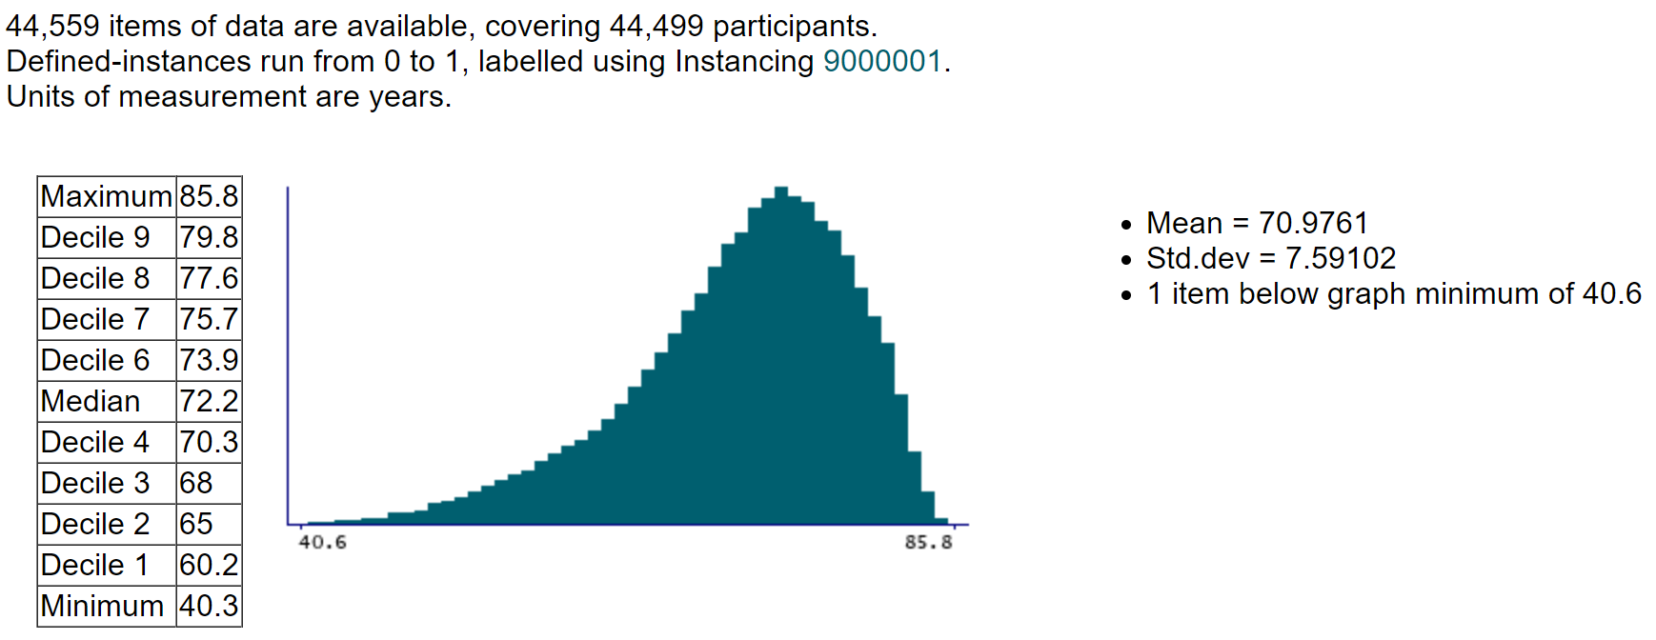
Age at death

Slide 30
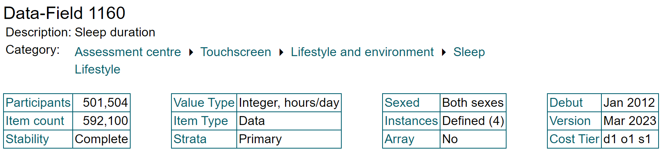
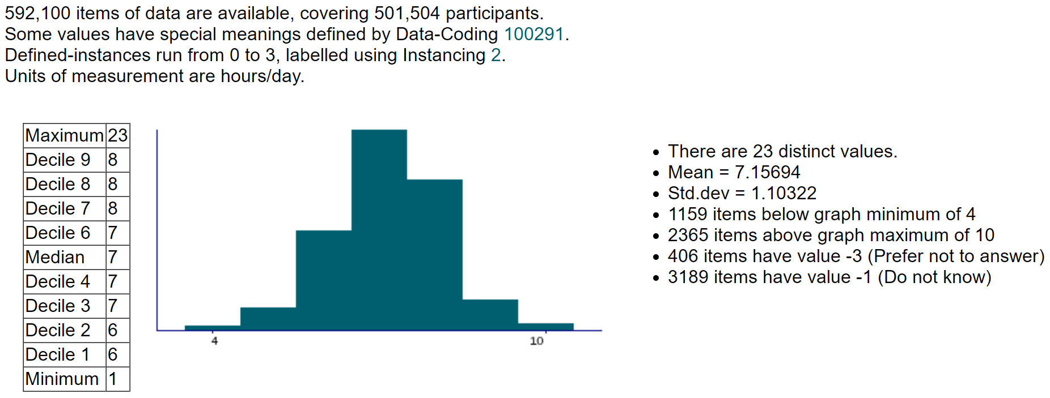
Sleep duration

Slide 31
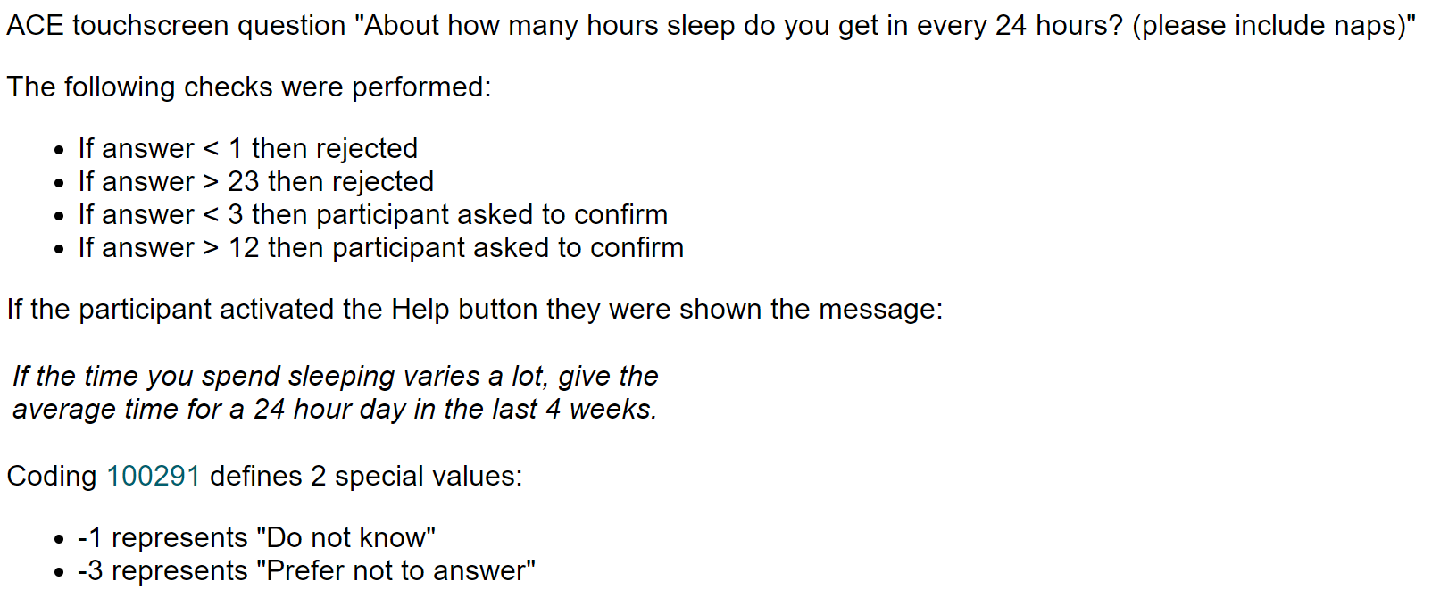
Sleep duration

Slide 32
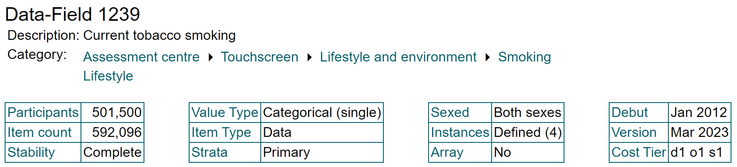
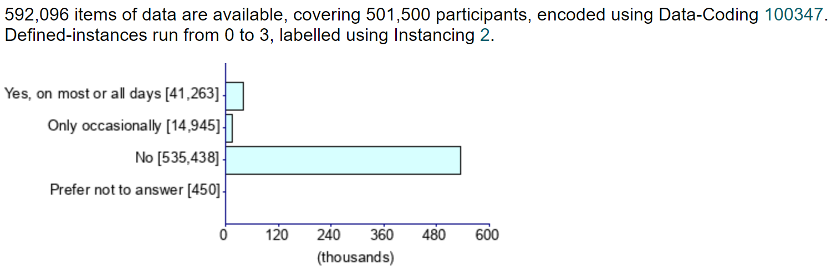
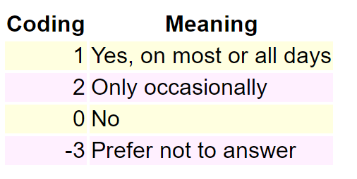
Current tobacco smoking

Slide 33
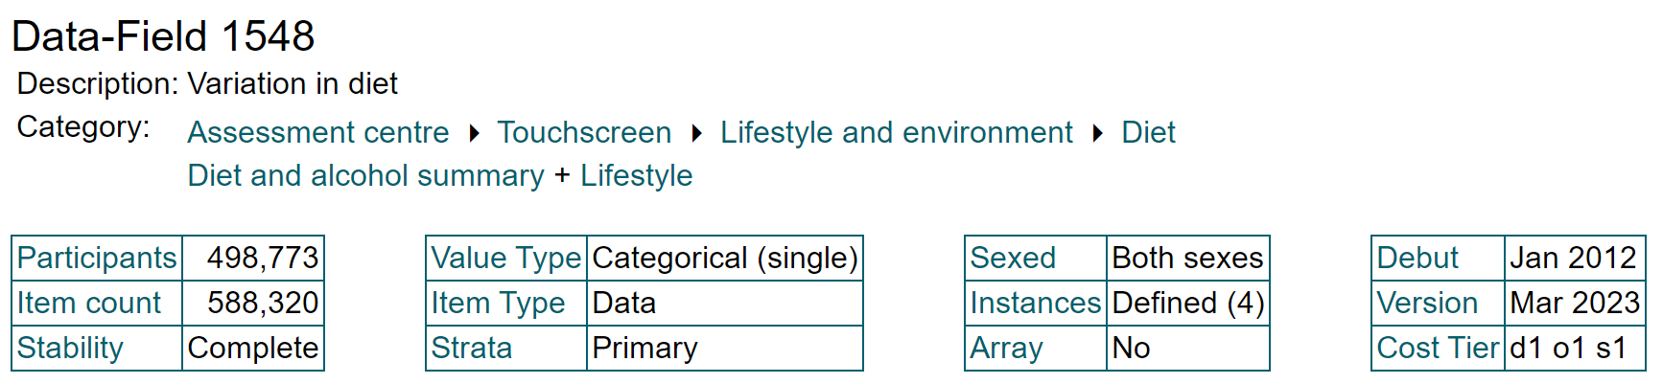
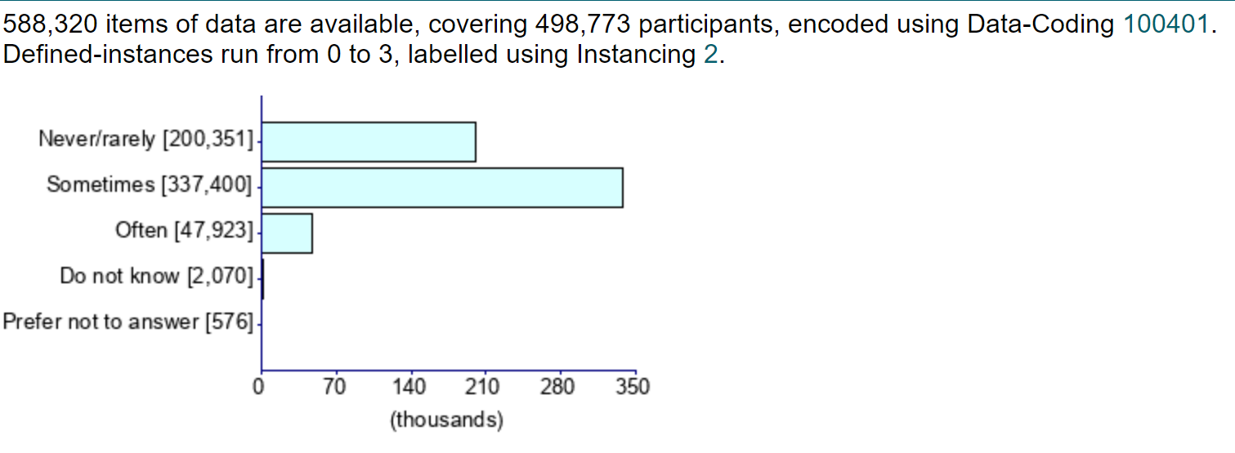
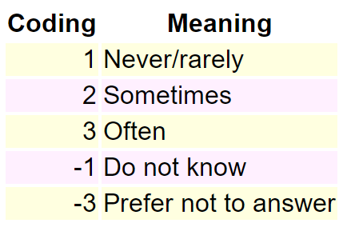
Variation in diet

Slide 34
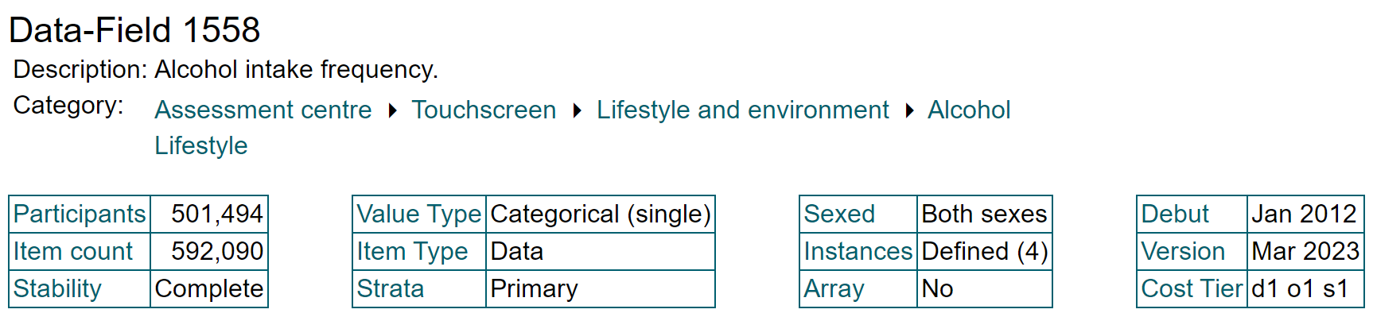
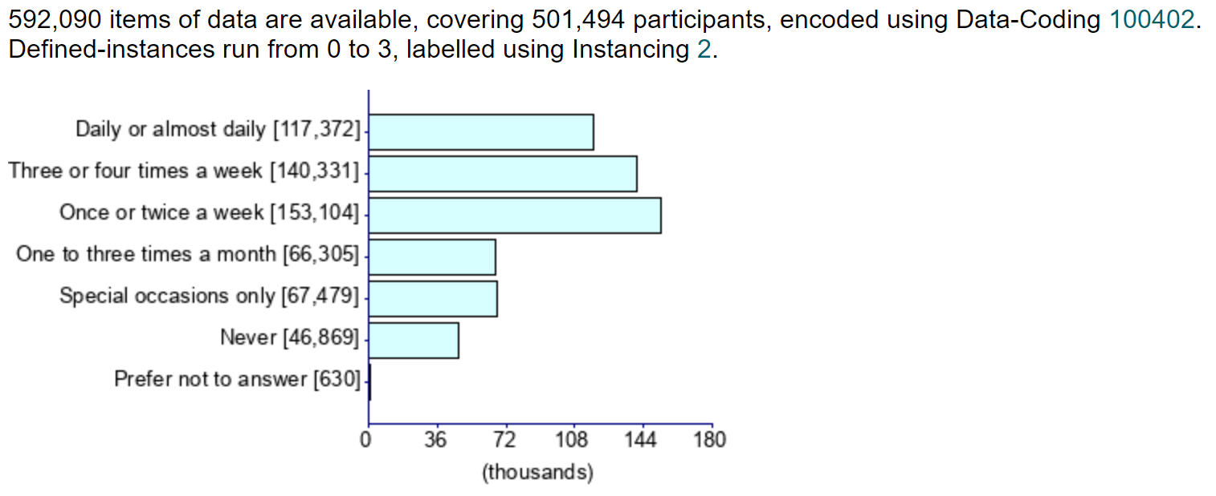
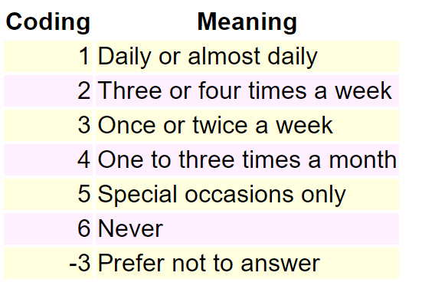
Alcohol intake frequency

Slide 35
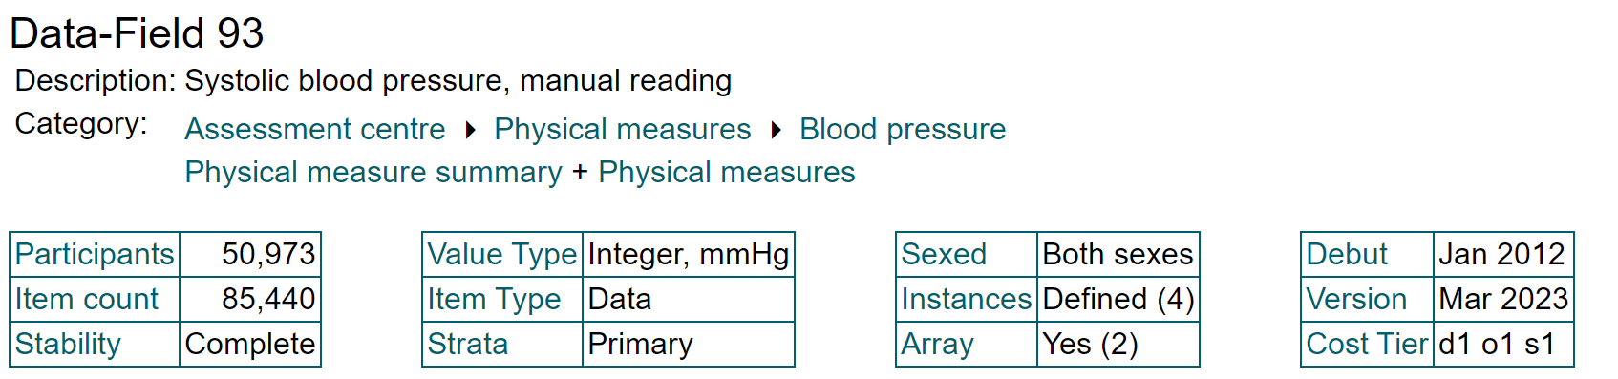
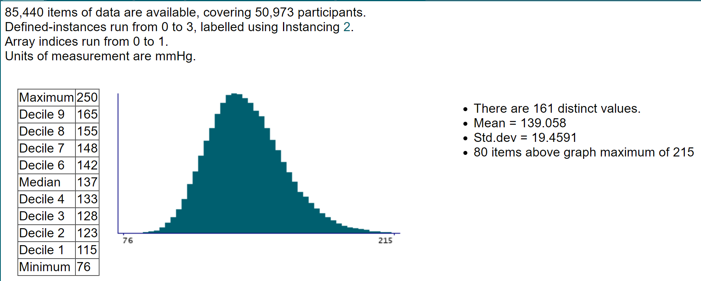
Systolic blood pressure, manual reading

Slide 36
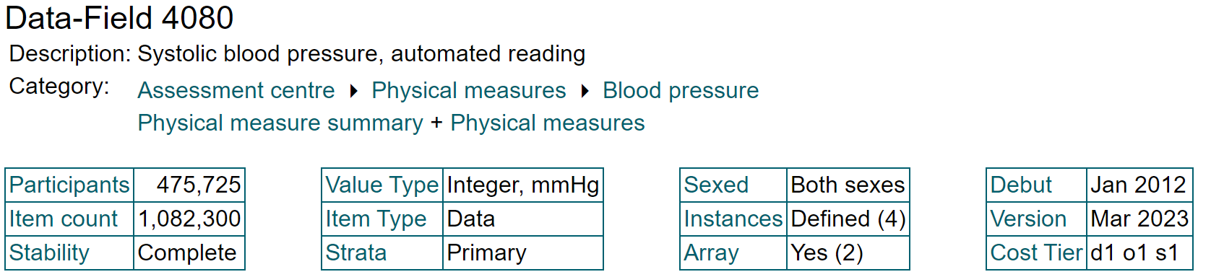
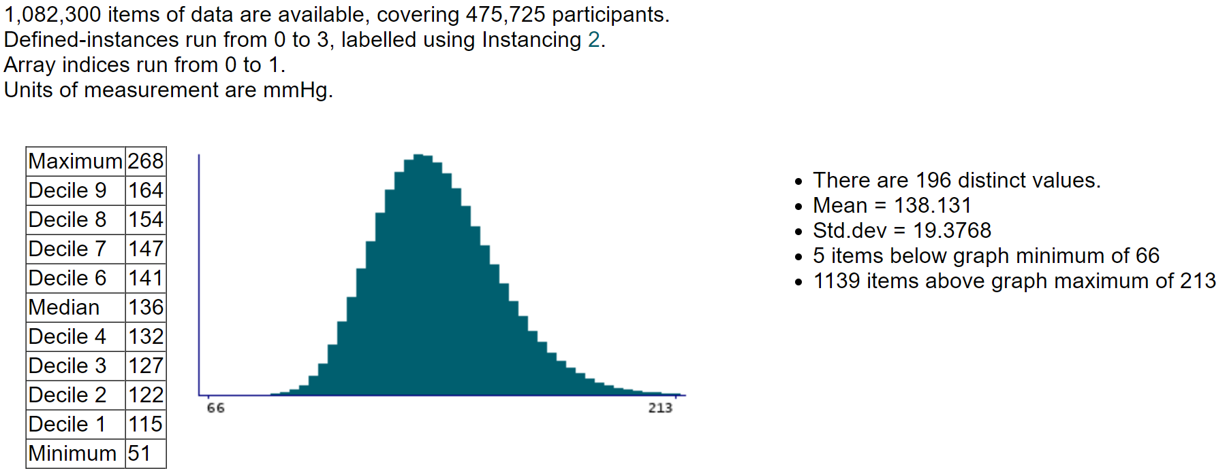
Systolic blood pressure, automated reading

Slide 37
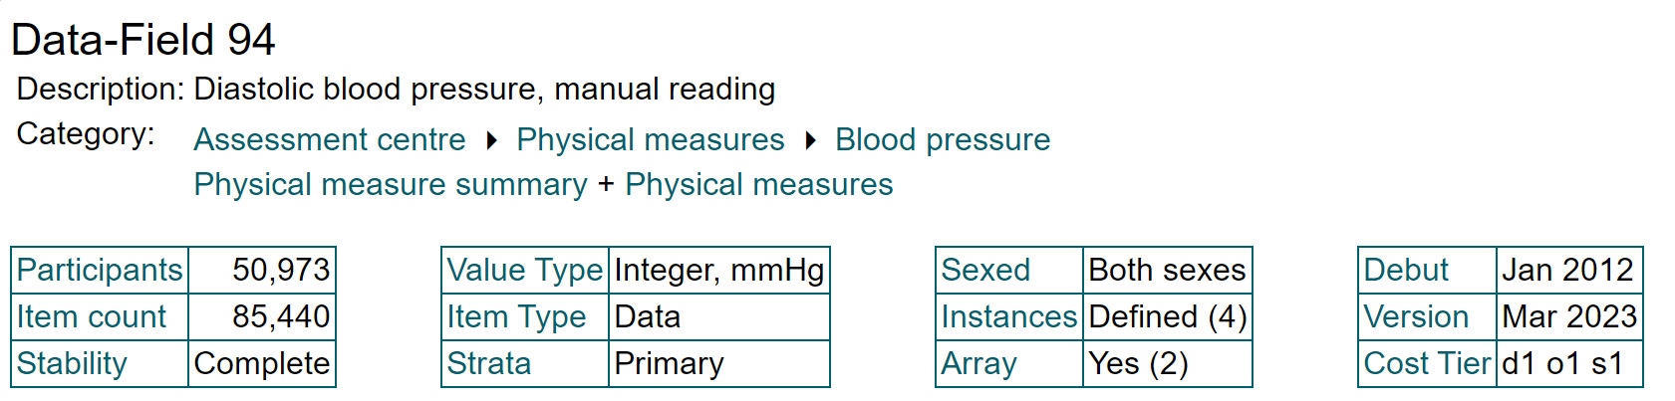
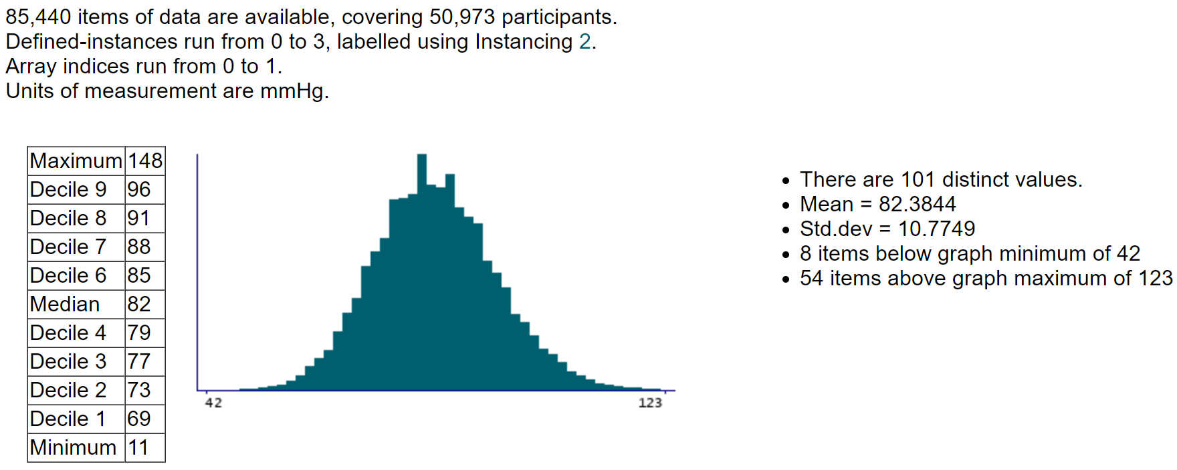
Diastolic blood pressure, manual reading

Slide 38
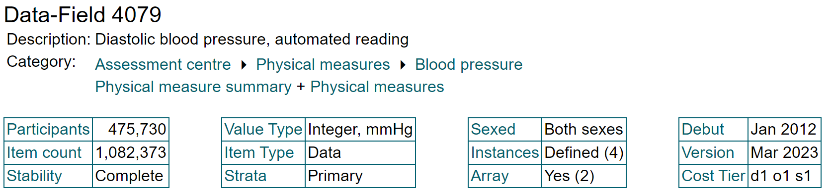
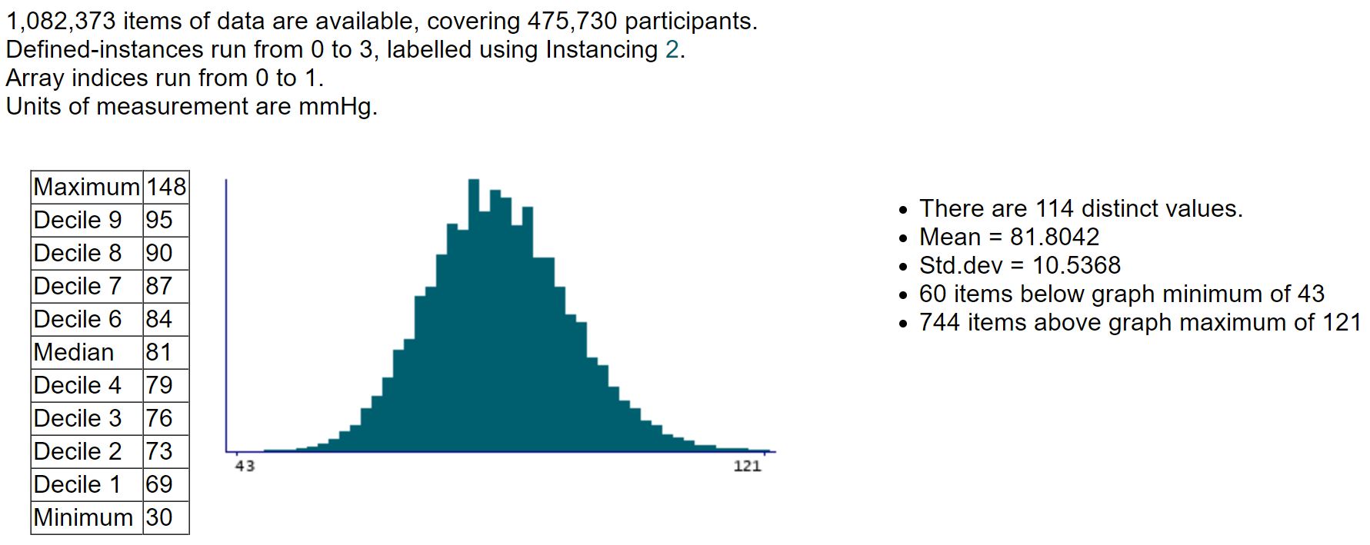
Diastolic blood pressure, automated reading

Slide 39
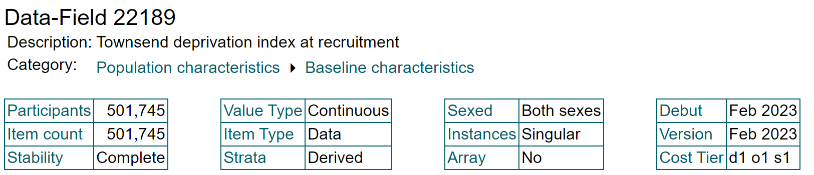

Townsend deprivation index at recruitment

Slide 40



Skin colour

Slide 41



Diabetes diagnosed by doctor

Slide 42



Qualifications

Slide 43



Frequency of strenuous sports in last 4 weeks

Slide 44



Seen doctor (GP) for nerves, anxiety, tension or depression

Slide 45



Wears glasses or contact lenses

Slide 46



Other eye problems

